Slide 1
Box Office Blueprint: Data-Driven Insights for Microsoft Movie Studio Launch.
Objective:
This project aims to guide the establishment of a new movie studio by providing actionable insights into the key factors driving box office success.
We explore data from IMDB, The Movie Database (TMDb), and the numbers to understand what types of movies perform well at the box office.
The goal is to extract patterns in genres, ratings, and other characteristics to guide the studio’s production strategy.

Slide 2
Business Problem.
The new movie studio lacks experience in filmmaking and needs insights to:
Identify successful movie characteristics.
Pinpoint profitable genres.
Determine optimal budget ranges.
Strategize release timings to maximize box office revenue.

Slide 3
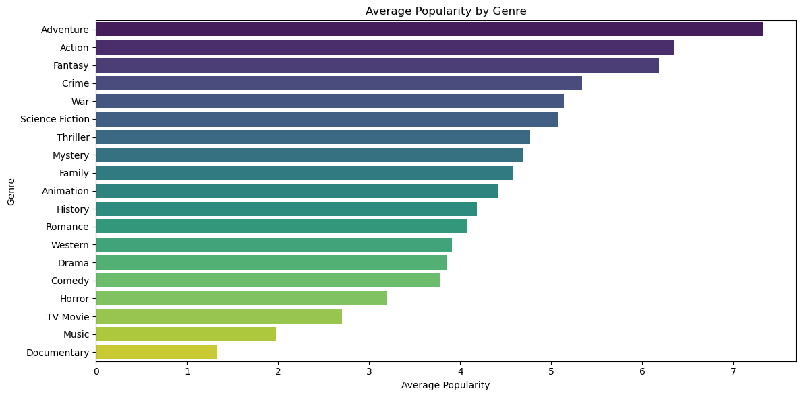
EDA Insights: Genre Performance
Action: Broad appeal, moderate ratings commercially strong.
Fantasy: High popularity and strong ratings ideal for balanced success.
Drama: Critically strong but appeals to a smaller audience.
Animation: Highest ratings — excellent for family and quality-focused markets.
Focusing on these genres allows studios to balance mass appeal with critical acclaim, driving both revenue and audience satisfaction.

Slide 4
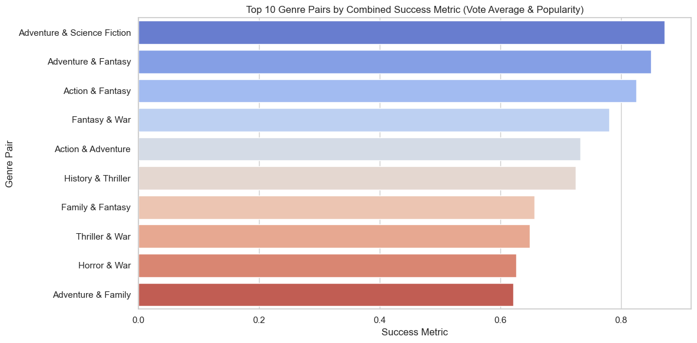
EDA Insights: Genre pairs by combination success metrics (Vote average& popularity)
1. Top Performer: Adventure & Science Fiction ranks highest with a success score of 8.7, blending excitement with futuristic or imaginative elements a strong box office and audience draw.
2. Strong Contender: Adventure & Fantasy scores 8.5, performing exceptionally well in terms of audience approval and reach. 3. Genres to Watch: Action $ Thriller shows solid popularity but lower average ratings, suggesting high audience interest but more mixed critical reception.

Slide 5
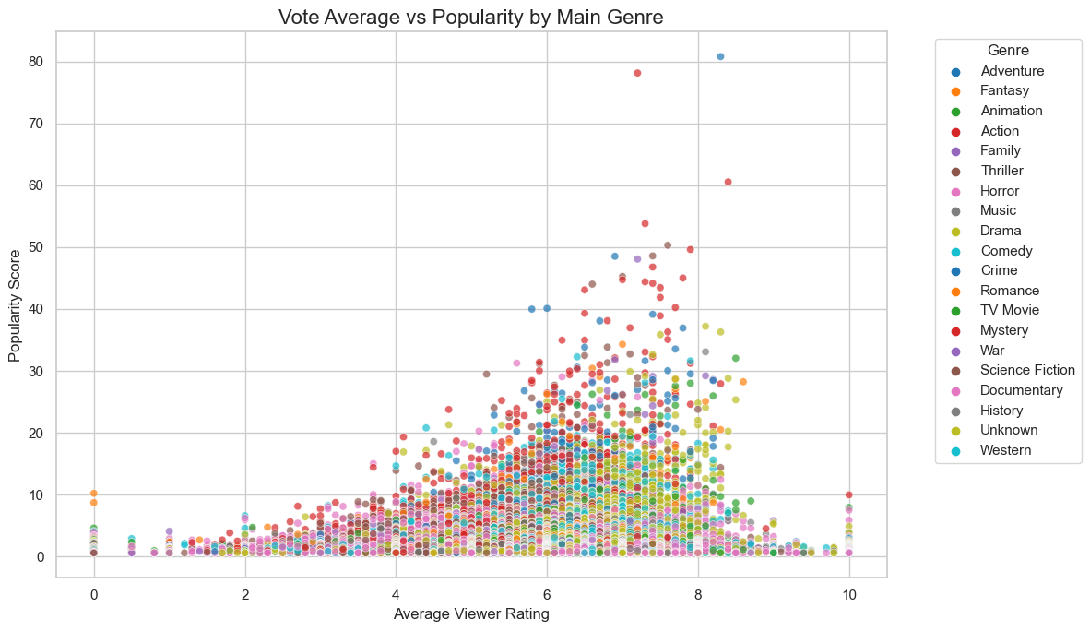
EDA Insights: Vote average vs popularity by main genre.
Viewer ratings ≥ 6 typically signal high popularity.
Action films are widely popular due to visual appeal but they often receive mixed or average ratings.
Drama, Animation and Family genres have gentler extremes, whereas Action, Sci-Fi, and Adventure tend to be more polarized with their reception.
When planning films, studios must consider the possible popularity level and how the audience will receive it.

Slide 6
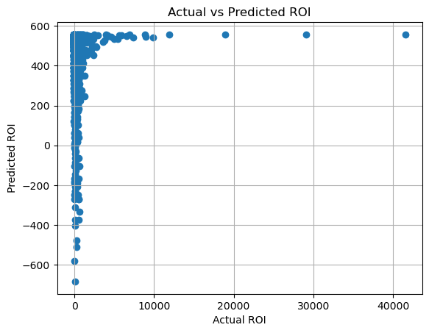
Regression Results.
A linear regression using production budget to predict ROI showed very weak predictive power (R² = 0.0069).
Key insight: Spending more doesn't guarantee better returns.
Budgets don’t reflect critical factors like marketing, distribution cuts, or backend deals.
To predict movie profitability accurately, we need more comprehensive financial data beyond just production costs.

Slide 7
Recommendations.
Focus on producing Action, Adventure, and Fantasy films.
Prioritize stories that resonate globally and generate online engagement.
Consider genres that maintain consistent viewer ratings.
Boost vote count through marketing campaigns, early fan screenings, and sequels.
Leverage genre-specific tones and storytelling to match audience preferences

Slide 8
Next Steps
Conduct deeper modeling to predict box office revenue.
Integrate marketing and budget data for richer insights.
Test concepts with focus groups aligned with top genres.
Conduct deeper analysis into budget vs return per genre
Analyze international markets to align global preferences
Incorporate text sentiment from reviews to refine tone/style recommendations

Slide 9
Q&A / Conclusion
Conclusion: Data supports a clear strategic focus on Adventure, Action, and Fantasy. These genres offer consistent popularity, high audience engagement, and room for creative expansion.
Authors
Hafsa Mohammed
Ryan Karimi
Rose Muthini
Elizabeth Ogutu
Thank you

